Slide 1
Network Topologies
Traditional topologies:
  Star
  Ring
  Bus
Notes:
7
Have looked at how data can be transmitted over the media that are used to make computer networks. Now going to look at the shapes that these networks can take.
Traditional LAN shapes are:
- Star - all traffic controlled centrally
- Ring - Equipment connected in a ring
- Bus - Equipment distributed along shared media
We will look at these in more detail and then look at some other network topologies that exist.

Slide 2
Star Networks
Equipment connected centrally
Central machine has intelligence to route traffic
Notes:
8
With star networks:
- All traffic goes via a central machine
- Central machine can do necessary buffering of data
- Central machine has necessary intelligence to route (forward) the data.
- Early WANS in the UK academic community were this shape.
- Regional Computer Centres in London, Manchester, Bristol ,
Edinburgh and Newcastle
- Surrounding institutions would have their own smaller machines
and would send large jobs to CC
- Initially programs taken manually on punched cards.
- Then the smaller machines at the sites were connected to the CCs
- Protocols written to allow jobs to be submitted remotely.
- Gandalf terminal exchange at Aberystwyth. This was a controller with VDUs
attached to it in a star configuration. Similar to a telephone exchange, switched
terminal traffic

Slide 3
Star Network
Printer
Workstation
Workstation
Controller
Terminal
Modem
Server
Notes:
9
This is the topology of a star network
How robust do you think it is?
- All or nothing - loss of machine or a link does not affect the network
operation of the other equipment
- If the controller dies you lose everything
How secure do you think it is?
- All or nothing - if the security of the controller is breached all traffic
can be listened to.
- A secure controller results in security for all network traffic, as only
the machines themselves can see stuff on their links
How easy to add/remove a piece of equipment
- Easy - as long as enough ports on the controller and over small
distance.
- Wider distance leads to more cabling issues
How expensive to add a machine
- Quite expensive to lay all cables

Slide 4
Ring Networks
Equipment connected in a ring
Traffic travels around ring to its destination
Notes:
10
With ring networks:
- Traffic is put onto the network by one piece of equipment DTE
- It is broadcast in nature as all machines in the ring can see the data as it
passes.
- Traffic moves in one direction around the ring
- The data is removed from the ring by either the intended recipient of the
data or by the data originator.
- Low level acknowledgements. If the data originator does
not see the data again it knows that it was received.
- No routing or buffering required
- Example is the Cambridge Ring

Slide 5
Ring Network
Terminal
Workstation
Modem
Printer
Workstation
Server
Notes:
11
This is the topology of a ring network
How robust do you think it is?
- Not very robust - if ring breaks all equipment in front of the break is lost.
- Have self-healing rings - these rings have cable running in the opposite direction.
When the ring breaks the second cable comes into effect to complete the ring - draw
on board
- The redundant ring is not normally used in daily operation (wasteful?)
How secure do you think it is?
- As all traffic is braodcast can be unsecure.
- Machines that are running in promiscuous mode will pick up all traffic in addition to
the stuff addressed to them or their multicast group.
- Ring is secure if machines it connects are not running promiscuously.
How easy to add/remove a piece of equipment
- Very, just need a trunk coupling unit (TCU) to attach equipment to the media.
How expensive to install/addequipment
- No controller keeps cost down
- Cable costs lower than with a star network as shorter lengths - ring can cover quite a
distance

Slide 6
Bus Networks
Equipment connected by single shared medium
Data broadcast on medium to reach destination
Notes:
12
With bus networks:
- All traffic goes along a shared medium
- The ends of the medium need to be terminated.
- The terminators make the cable look infinite
- A DTE will put traffic out in both directions along the cable. If it is not
picked up it will stick to the terminator at the end.
- DTE on medium check address of traffic and reject if not theirs
- Traditional Ethernet (co-ax) networks are bus networks.
- In some cases reflections of the data along the wire will occur that will
lead to congestion as the traffic is travelling uneccesarrily.
- Changing the electrical properties of the wire will have this effect:
- Kinks in the wire (rules about laying coax)
- Unterminated wire

Slide 7
Bus Network
Workstation
Modem
Terminal
Printer
Server
Workstation
Notes:
13
This is the topology of a bus network
How robust do you think it is?
- If media is damaged then it will stop working
- Some cases where it is broken will get some, if poor, performance
but broken media has the same effect as unterminated media
How secure do you think it is?
- Like ring networks, bus networks work by broadcast and so can be
unsecure if the machines it connects are operating in promiscuous mode.
How easy to add/remove a piece of equipment?
- Easy to add another piece of equipment
- Like ring just need transceiver to connect to the media.
How expensive to install/add equipment?
- Again, like ring no need for a controller, which keeps the cost down
- Also like ring the media can be laid all over the place to cost of adding
more equipment is kept down.

Slide 8
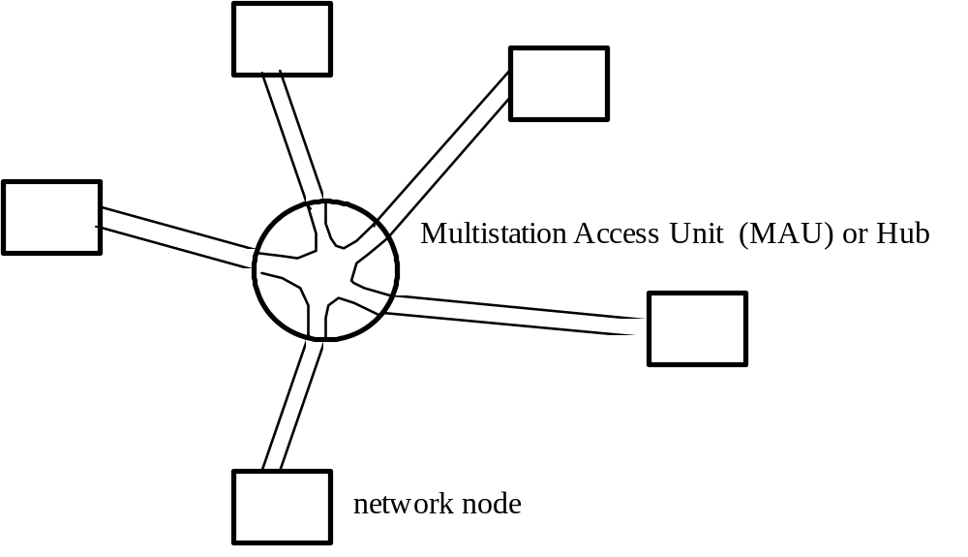
Physical and Logical topologies
Consider the following ring:
Notes:
14
to clear up any possible confusion
some ring or bus topologynetworks may look physically like a star
When configured with switches or hubs they become star shaped.
- 10 Base T has a star topology with twisted copper cable - longer lengths
like phone cable
- 10 Base F has a star topology with fibre cables.
- 10 Base T mainly - unshielded twisted pair cables go from DTE to
the switch or hub. Hubs will repeat the signal to all the machines it
connects, switches will send traffic only where it needs to go unless on
a broadcast address
- 10 Base F to Physics building and solarium
MAU can automatically bypass failed stations
may be av\ble to use existing wiring eg. twisted pair telephones

Slide 9
Media Access
LAN users share common media
Need to decide who has ‘right of way’
Notes:
23
We are now going to move on to look at media access
Most LANs have common media that is shared by all of its users
We need a mechanism of granting access to the media for the users
We need to decide
- Who can use the media
- When they can use it if the media is already occupied
Within a DTE there is a medium access control (MAC) unit.
This unit operates to avoid contention with other transmissions on a medium when the DTE wants to transmit some data.
We are going to look at the different mechanisms that can be used to grant access to the media to a DTE that wants to transmit some data

Slide 10
Carrier Sense Multiple Access (CSMA)
Look to see if the media is in use, if so back to 1
Transmit information
Back to 1
Notes:
24
Carrier Sense Multiple Access (CSMA)
- Approach that can be taken by an (Ethernet/bus) network to allow
transmission of data by the DTEs that it connects. Remember that DTE
on a bus network broadcast their transmissions in both directions up the
cable, so would collide with other transmissions being sent at the same
time
- The MAC unit will block waiting for the media to be free (step 1)
- When the media is free it will transmit its data (step 2)
- Cable not multiplexed in the traditional sense. No set time slot. Free-
for-all. Multiplexed in as much as more than one DTE can believe that it is in the process of delivering a message at any one time.
Problems with CSMA
- If two MAC units look at the same time (or approximately the same
time) to see if the network is free, and it is, then they will both transmit
an a collision will occur. Therefore, does not provide a reliable service
CSMA is usable, but higher layer network protocols will have to recover from the unreliable service that it offers.

Slide 11
CSMA with Collision Detection (CSMA/CD)
Look to see if the media is in use, if so back to 1
Transmit data
Look to see if a collision has occurred, if so transmit JAM and delay
Go back to 1
Notes:
25
CSMA/CD
- Version of the CSMA mechanism that deals with the problem of two
MAC units transmitting data at the same time
- The MAC unit will block waiting for the media to be free (step 1)
- When the media is free it will transmit its data (in whatever chunks are
allowed by the network (e.g. packets, messages) (step 2)
- When the data has been transmitted the MAC unit will monitor the
network to see if its data has collided with the data of another DTE
- If a collision is detected then the MAC transmits a jam sequence to
indicate to the other DTEs that a collision has occurred.
- The MAC unit then delays before going back to wait for a free network
for retransmission (steps 3 and 4)
- The delay is random on each DTE so that they don’t all try to retransmit
at the same time
Neil more detail on CSMA/CD next week

Slide 12
Token Passing
Logical ring links all DTEs connected to media
Token passed around the ring
Kept by a DTE that wishes to transmit data
Token passed on when data transmitted
Notes:
26
Token passing system is another way of controlling access to shared transmission media.
- Logical ring of the DTEs connected to the physcal media is established
- Control token for the ring is created.
- Token is passed from DTE to DTE around the ring
- Set of defined rules for passing the token adhered to by all DTEs
- When token received by a DTE waiting to transmit, the DTE transmits
its data and then passes on the token to the next DTE in the ring.
- Need not be a ring topology, can also be on a bus topology - the ring that
is set up is logical only.
- When in a bus topology can have DTEs that are not part of the logical
ring. These DTEs can receive data only as they will never own the
control token.
- All DTEs have the ability to monitor the logical ring.
- Only one DTE at a time has the responsibility for monitoring the ring
and, with it the responsibility for initialisation of the connection of the
logical ring and recovery from the loss of the token.
- Token loss can occur if a DTE fails to take the token at any time, or if the DTE
with the token dies.
- A time is set for ownership of the token to prevent token hogging
- Similar to the trains to Aberystwyth

Slide 13
Slotted Systems
Ring initialised to contain a fixed number of bits
Ring split into slots of a fixed number of bits per slot
stations wait for an empty slot and put data in for transmission
Notes:
27
Slotted systems are used to control access to ring networks.
- Special monitor machine on network initialises a fixed no. of bits on the
ring and ensures that this number is maintained
- Bits circulate the DTEs on the ring constantly.
- Each DTE reads each bit and passes it on.
- The complete ring is split into slots of a fixed number of bits.
- The slots have a full/empty marker and initially all the slots are marked as empty.
- DTEs wait for an empty slot, set the marker to say it is full and put their
data into the slot with an address
- The slot circulates the network with each DTE examining it to see if it contains its
address. If the address matches then the DTE extracts the data from the slot and
passes it on around the ring.
- The source DTE waits for the slot to come back round and marks it as empty.
- A DTE can have only one slot at a time on the network. It must also
release a slot it is using before transmitting another one making this a
very fair system as all DTEs get a go at transmitting.
- The monitor checks for slots that have not been freed and marks them as empty.
- Requires an extra monitor station - expensive
- Can be seen to implement a kind of TDM
- Main implementation in the Cambridge Ring, technically sound, but didn’t catch on
abroad although taken up a bit in the UK.
- Theoretically could have receiver mark slot as empty, second half of ring used

